Slide 1

Smart education
& e‑learning platform
PRESENTED BY
K. Ramyasri
2620080066
G. Gouthami
2620030328
K. Pravalika
2620030144
B. Sriram Viloch
2620030127
Learn anytime, anywhere
Jeswanth Sidharth
2620030659
S. Satvik
2620030607

Slide 2







What is smart education?
Smart education uses technology in learning.
It connects students, teachers, and resources.
It makes learning simple, flexible, and effective.
Students can learn anytime and anywhere.
It supports personalized learning for everyone.
IN FIVE WORDS
It includes digital tools and online platforms.
Connected
Smart tools
Flexible learning
It prepares students for a better future.
Anytime, anywhere
Better future

Slide 3






How smart education works
01
02
03
04
Student
Digital platform
Personalized content
Practice & activities
Smart education is not just about watching videos. It is a continuous learning cycle.
05
06
07
Assessment
Learning analytics
Feedback & improvement

Slide 4





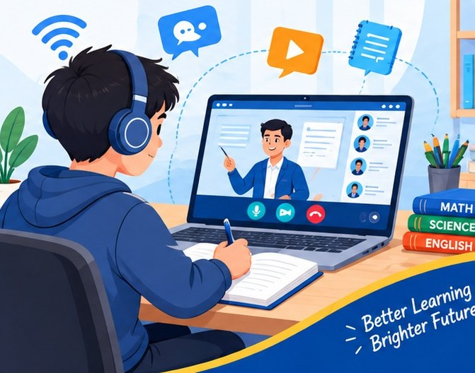





What is an e-learning platform?
A digital environment where students and teachers can:
Learn
Practice
Assess
Receive feedback
Improve
It can provide
Live classes
Assignments
Recorded lectures
Doubt-solving
Notes and e-books
Progress reports
Quizzes
Teacher communication

Slide 5





Examples of e-learning platforms
Live online classes and personalized learning for school students.
Comprehensive learning app with videos, courses and adaptive learning.
Learn from top educators through live classes and structured courses.
Video conferencing platform for live classes, meetings and webinars.
Free tool by Google to manage classes, assignments and communication.
Live interactive classes
Study material & notes
Tests and practice sessions
Real-time doubt solving
Concept video explanations
NCERT solutions & study materials
Mock tests and assessments
Personalized learning path
Live classes by top educators
Structured video courses
Practice quizzes and tests
Community learning & doubt support
HD video and audio meetings
Screen sharing and whiteboard
Record sessions for later
Breakout rooms for groups
Create and manage classes
Assign and collect assignments
Integrates with Google Drive
Communicate and give feedback
Different platforms, one goal: better learning for all.

Slide 6

CASE STUDY
Vedantu
An e-learning platform

Slide 7




Vedantu: origin
Founded in 2011 by Vamsi Krishna, Pulkit Jain, Anand Prakash, and Saurabh Saxena.
Started as an online tutoring/education platform.
Based in Bengaluru, India.
2011
The name comes from Veda + Tantu, meaning "knowledge network."
Founded
It aims to connect students with teachers through online learning.
Bengaluru, India
Learn | Practice | Excel

Slide 8




Problems identified
Students may not have access to experienced teachers in their local area.
Large classrooms can make individual attention difficult.
Students have different learning speeds and needs.
Travelling to coaching centres takes time.
Educational resources may not be equally available everywhere.
Students need convenient ways to ask questions and clear doubts.

Slide 9

Vedantu's solution
Live interactive classes connect teachers and students in real time.
Students can ask questions and clear doubts during learning.
Classes can be accessed using smartphones, tablets, or computers.
Recorded lessons can be used for revision.
Quizzes, assignments, practice tests, and study materials support learning.
Vedantu also provides both online and offline learning options.

Slide 10
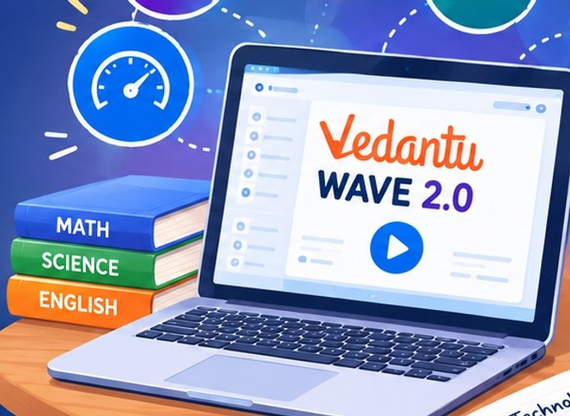




Technology used
Vedantu developed its technology around interactive online learning.
Its WAVE platform is designed to make online classes more interactive.
WAVE 2.0 includes digital interaction, quizzes, drag-and-drop activities, and engagement measurement.
40%
Vedantu says WAVE 2.0 was designed to use 40% less bandwidth than other platforms, helping students with limited internet speeds.
less bandwidth
AWS infrastructure has also been used for video delivery, data processing, security, and large-scale online learning.
Vedantu's own claim for WAVE 2.0

Slide 11

Learning process
01
02
03
04
05
06
07
08
Student
Select course
Attend live class
Ask doubts
Practice
Assessment
Performance feedback
Revision

Slide 12


Advantages and disadvantages
Advantages
Disadvantages
Learn from anywhere – reduces geographical barriers.
Internet dependency – poor connectivity can interrupt classes.
Live teacher interaction – students can communicate with teachers.
Device dependency – students need a suitable device.
Personalized learning – learning can be adapted to student needs.
Increased screen time – prolonged digital learning can increase screen exposure.
Doubt solving – students can ask questions during learning.
Distractions – students studying at home may be distracted by other apps or activities.
Digital resources – notes, assignments, quizzes, and tests are available.
Less physical interaction – online learning cannot completely replace the social experience of a classroom.
Convenience – reduces the need to travel to coaching centres.
Technical problems – device, application, audio, or network problems can affect classes.
Recorded lessons – useful for revision and missed classes.
Self discipline required – students need to stay focused and manage their time.
Technology-based learning – interactive tools can make lessons more engaging.
Affordability – paid programs may not be suitable for every family.

Slide 13

Major challenges and impact
Major challenges
Impact and achievements
Maintaining student engagement during online classes.
1.4 lakh+
2,000+
Delivering reliable live classes to a large number of students.
daily active students
teachers
Maintaining consistent teaching quality.
12 million+
30+
Managing increasing technology and infrastructure requirements.
students
offline centres
Competing with other EdTech platforms.
Expanded beyond a single location, reaching many cities and countries.
Making online education accessible to students with weaker internet connectivity.
Expanded into offline learning centres.
Protecting students and maintaining a safe digital learning environment.
Shows how e-learning can scale teaching beyond traditional classrooms.
Company-reported figures; they can change over time.

Slide 14

Improvements and future ideas
Improvements
Future ideas
AI-based personalized learning to identify individual learning gaps.
Global learning community – connect students and teachers worldwide.
Low-bandwidth learning for areas with weak internet.
AR/VR learning experiences for immersive education.
More interactive games and activities to improve engagement.
Advanced AI tutors with real-time doubt solving.
Better integration of online and offline education.
Learning analytics for better career guidance.
Clearer parent/student progress reports.
More learning formats like short videos, podcasts and micro-lessons.
Strong privacy and digital-safety measures.
Stronger community features for peer learning and mentorship.
More affordable options for students from different economic backgrounds.

Slide 15

Government schemes in digital education
The Government of India has developed several initiatives to expand digital education.
IMPORTANT EXAMPLES
PM e-VIDYA
DIKSHA
SWAYAM
NDEAR
NISHTHA
SWAYAM PRABHA
Virtual Labs

Slide 16




DIKSHA: origin
Launched in 2017.
Developed by NCERT.
Supported by the Ministry of Education, Government of India.
2017
Provides digital learning resources for students and teachers.
Launched
Ministry of Education · NCERT

Slide 17

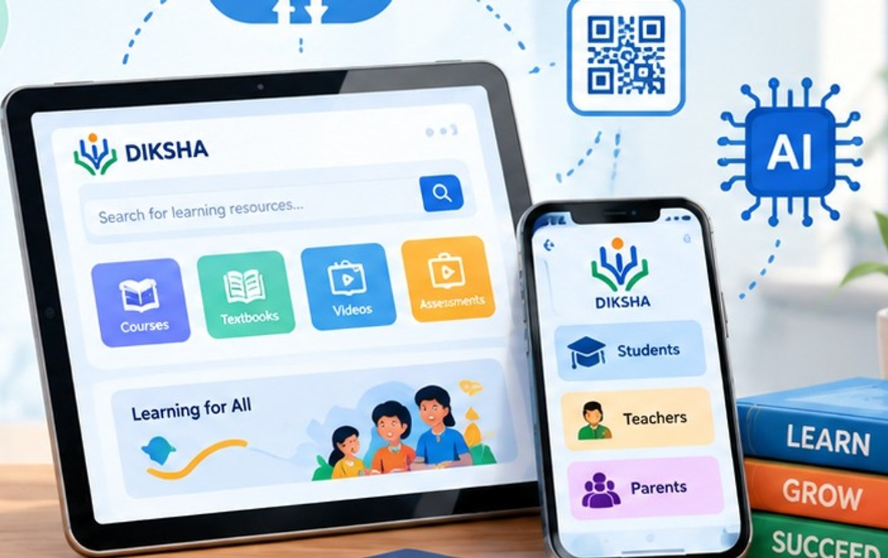


Technology used in DIKSHA
Mobile & web applications
Cloud technology
QR codes
Online learning content
AI & data analytics

Slide 18
Problems and solutions in DIKSHA
Problems
Solutions
Lack of study materials
Free digital resources
Limited access to teachers
Online learning support
Difficulty accessing textbooks
QR-code based content
Language problems
Content in multiple Indian languages
Teacher training difficulties
Online teacher training courses

Slide 19



E-learning platform vs government school
E-learning platform
VS
Government school
Online learning
Offline/classroom learning
Uses mobile/computer
Teacher teaches face-to-face
Learn from anywhere
Fixed location
Flexible timing
Fixed school timing
Digital videos & notes
Books & classroom activities
Main difference: e-learning → online government school → classroom

Slide 20

How to improve government schools
1
Provide smart classrooms and computers.
2
Improve teacher training.
3
Provide better study materials.
4
Improve internet and electricity facilities.
5
Give extra support to weak students.
Better schools, brighter futures

Slide 21

Research and critical analysis: advantages
For students
For teachers
For government
Personalized learning
Digital teaching resources
Wider educational reach
Flexible access
Student-performance information
Scalable digital resources
More learning resources
Easier resource sharing
Better data for planning
Interactive activities
Professional development
Support for multilingual education
Self-paced revision

Slide 22



Disadvantages and challenges
Digital divide
Digital literacy gaps
Privacy and data-security concerns
Poor internet connectivity
Teacher training requirements
Quality control of online content
Lack of devices
Student distraction
Accessibility for students with disabilities

Slide 23








The digital divide
Problem
Solution: smart education should include
A student with
Offline content
Smartphone
Good internet
Reliable electricity
Downloadable lessons
Low-data applications
may have a very different learning experience from a student with
Shared school devices
No personal device
Weak connectivity
Unreliable electricity
Digital classrooms
TV/radio-based alternatives
Local-language content

Slide 24



Future scope
AI-based personalized learning
Learning tailored to each student's needs and pace.
Multilingual AI tutors
Support in multiple Indian and global languages.
VR/AR laboratories
Hands-on learning through virtual and augmented reality.
Intelligent learning analytics
Track progress and predict future needs.
Adaptive examinations
Questions adjust to the learner's level and performance.
Coding and skill-based education
Build real-world skills for the future job market.
Digital career guidance
Personalized advice for different career paths.
Greater teacher collaboration
Share resources, ideas and best practices easily.
Integration with government digital infrastructure
Connect with national platforms like DIKSHA, ePathshala, etc.

Slide 25

Thank you
For your time, support and attention.

